Slide 1
Economic, Political, and Social Philosophy
By Katherine Kim
Period 5

Slide 2
Auguste Comte
Philosopher who sought out a comprehensive philosophical system that would include all human knowledge
Positivism- written in 10 volumes published between 1830 and 1845
Stated the key to civilization= humanity’s understanding of the world developed in the theological, metaphysical, and positive stages in history
More information on Positivism
Look for links to click like the one to the left

Slide 3
Karl Marx
Trained in German philosophy along with economics and radical thought
Wrote Communist Manifesto with Friedrich Engels
A call to action with a philosophy of history
Exiled to London where he spent the rest of his life devoted to his writings
During this time he wrote a comprehensive treatise, Das Kapital
More on Marx and his writings

Slide 4
Marxism
Additional Information
Marxism is a philosophy- a political doctrine from the economic and social philosophy of Karl Marx
Based on the principle that economic conditions determine the nature of society
Followers believed capitalism will lead to a classless society
Appeals of Marxism
Sees society as a whole, explaining historical change
Accepts and hails industrialization as a benefit
Rich in moral judgments without creating issues with any ethical system

Slide 5
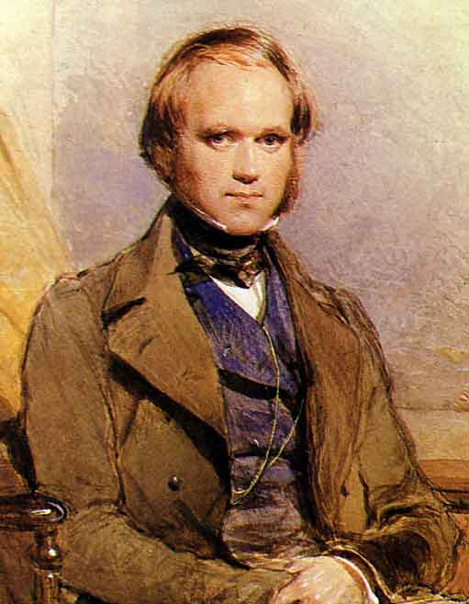
Social Darwinism
Taking Charles Darwin’s theory of evolution and applying it to society
Thomas Huxley was a very important propagandist for Darwin’s theories
Views of male dominance over women
Often on the side of reactionary ideas
Social Darwinism
Charles Darwin

Slide 6
Domestic Politics
Large-scale organizations were put together by social groups throughout Europe
Among these workers who formed trade unions who negotiated for a particular industry or mobilize major strikes
Some formed associations that set standards, and lobbied governments
Trade Unions

Slide 7
Socialism
The government takes a role in equalizing burdens in society
Includes dealing with work hours and wages
By doing this it spreads the burden throughout society
Less work for workers, richer pay higher taxes
Intro to Socialism

Slide 8
Imperialism
Extension of a country’s power and sphere of influence through diplomacy or military force
This was done many times by the use of missionaries to spread a country’s faith in a foreign land
Mother land felt as if they were doing the indigenous people a favor by giving them these resources
More on imperialism
Need to go back to the other slide for comparison?

Slide 9
Colonialism
The mother country transplants its own citizens onto a foreign land and imposes the home country’s language, laws, economic systems, customs, education, and religion
These are brought on to influence the indigenous people
India was where many countries set up colonies because of the natural resources
Better look at the Map

Slide 10
Nationalism
Sense of national feeling or being a part of a whole
Instead of representing a household or neighborhood people began to be educated in that they are part of something bigger than their villages
Strengthens a country
Click on the picture for more on nationalism

Slide 11
Economics
For review see pgs. 738-743 in the Chambers textbook
With the aid of technology, education, and other advances in science and transportation made the economy prosper during this period

Slide 12
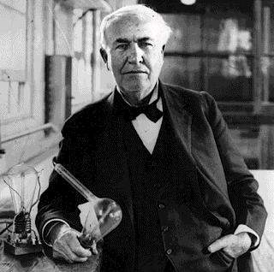
New Technologies
Thomas Edison- invented the incandescent light bulb leading to power stations that were able to distribute power over an area
The steam turbine was more efficient that the steam engine and put in many ships and factories
New chemicals also made improvements in items such as dyes, textiles, fertilizers and explosives
More on new technologies of the time period
Thomas Edison holding his invention in the background

Slide 13
Industrialization
Increasingly industrialized world
The United States showed the industrial potential and saw economic growth
Appealed to the immigrants that went there to supply needed labor and schooling
Created a consumer society
19th century and industrialization

Slide 14
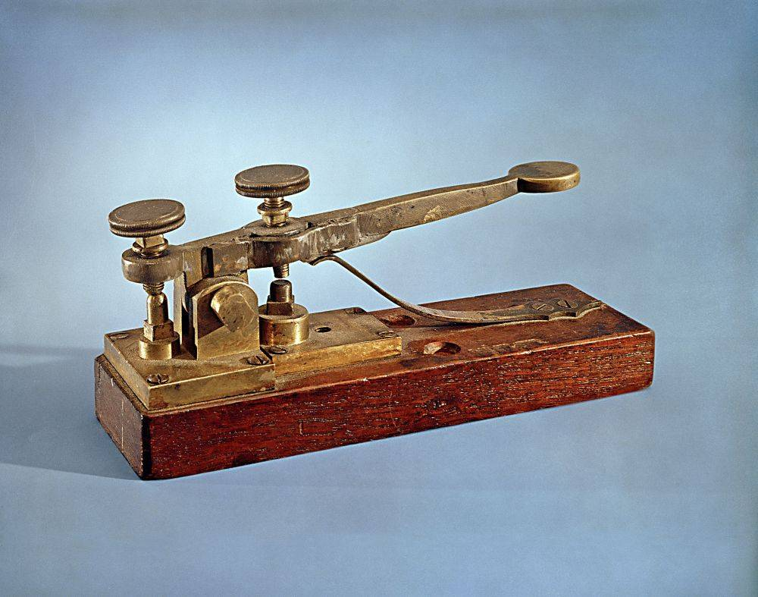
Improvements in Communication
Improvements such as the telegraph and the telephone helped with the economic improvement
Trains and modes of transportation also played a key role
Newspapers became more affordable to the common people and were a main way to spread ideas/news
The increased access to these allowed:
more goods to be available in more places
Spreading of news quickly
People were able to access more markets quicker and more affordably
What is in the background?
To find out click the question
mark!

Slide 15
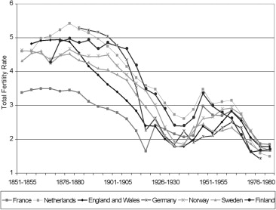
Demographic Changes
Rapid decline in mortality rates and patterns of a declining birth rate marked this time period
This resulted in:
Improved sanitation
Upgraded, better diet
Virtual elimination of some diseases
Decline in child labor
For a better look at the graph
(scroll down; several different
representations)

Slide 16
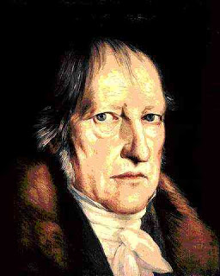
Georg Wilhelm Friedrich Hegel
Set the tone for 19th century intellectuals
Created a philosophy as comprehensive as one of Aristotle
Determined to reconcile the differences and contradictions between science and faith
Believed that the key was in the meaning of history and nature of historical process
More on Hegel

Slide 17
Anarchism
Radical thought that called for the abolition of the state
Anarchists assassinated the president of France, the prime minister of Spain, the empress of Austria, the king of Italy, and the president of the United States
More on Anarchism

Slide 18
Anti-Semitism
Definition: An anti-Jewish sentiment used to reinforce conservative, anti-liberal, and nationalist politics
Against the rise of current opposition to liberal society
Followers claimed Jewish had a lack of patriotism used to discredit France
Jewish seen as a symbol of a liberal, capitalist society
Learn more about anti-Semitism

Slide 19
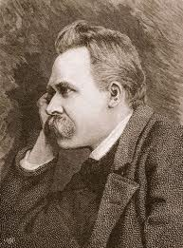
Friedrich Nietzsche
Philosopher that emphasized human will
Had great disdain towards ideas of equality and democracy
Hated nationalism and militarism
Rejected his society and claimed the only hope for the future was the work of powerful men who would discard the reserves of the bourgeois society
More on me? Hmmm

Slide 20
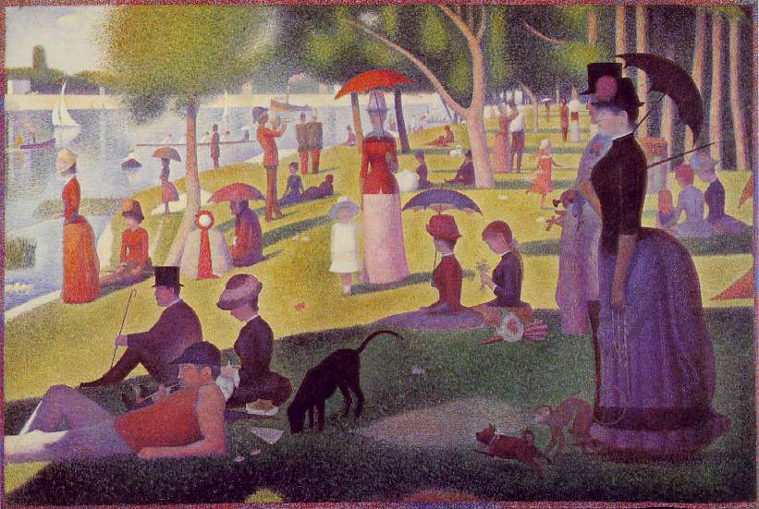
Sports Teams and Leisure
With labor laws that shortened the work week to 5 ½ days workers had more leisure time
Sports teams were created to feel a sense of community
It also gave people something to do while being physically active
More on leisure
Art in the background by Seurat

Slide 21
What do you remember?
Who was Karl Marx and what was Marxism?
Why were sports teams an important part of nationalism?
How did some of the views from this time period effect places other than Europe?
In what ways were new technologies beneficial to the economic growth?

Slide 22
The End!
Unless you need to go back…

